Slide 1

Hybrid-Enhanced Quantum Evolution Search (H-HQES)
(Batch No: CBIT/IT/2025-26/IT1/108)
Under the Guidance of:
Dr. T. Satyanarayana Murthy
Associate Professor, IT, CBIT
Presented By
G.Vyshnavi, 160122737005
J. Sai Teja, 160122737044
N. Shresta, 160122737307
Review-1: Project Part-2, Department of Information Technology

Slide 2
AGENDA
Abstract
Problem Statement
Objectives
Existing Idea
Proposed Methodology
Results
Department of Information Technology

Slide 3
PROBLEM STATEMENT
The Traveling Salesman Problem (TSP) is a difficult optimization problem where finding the shortest route becomes harder as the number of cities increases. Earlier quantum methods based on Grover’s search used amplitude amplification and complex circuits, which are not practical for current noisy quantum devices.
To improve this, the project upgrades the approach from Grover’s algorithm to the Quantum Approximate Optimization Algorithm (QAOA). QAOA is a hybrid quantum–classical method that treats TSP as a cost minimization problem and gradually moves toward the best route using adjustable parameters.
The goal is to design a QAOA-based solution that is simpler, more scalable, and suitable for present-day quantum systems.
Department of Information Technology

Slide 4
ABSTRACT
The Traveling Salesman Problem (TSP) is a difficult optimization problem that aims to find the shortest possible route visiting all cities exactly once. In our previous work, we used a Grover-based Two-Step Quantum Search (TSQS) approach, which amplifies optimal solutions using oracle-based marking. Although effective, this method requires extra qubits and deep circuits, making it complex for real quantum hardware.
In this project, we replace Grover’s algorithm with a quantum evolution approach using the Quantum Approximate Optimization Algorithm (QAOA). Instead of marking optimal tours, we encode the tour cost into a Hamiltonian and allow the quantum system to evolve. A classical optimizer adjusts the parameters to increase the probability of low-cost tours.
Results show that the QAOA-based method significantly reduces circuit width and depth while still identifying optimal or near-optimal tours. This makes it more scalable and suitable for current quantum devices.
Department of Information Technology

Slide 5
PROJECT OBJECTIVES
Replace Grover-based TSQS with QAOA-based quantum evolution.
Encode TSP cost as a Hamiltonian energy function.
Optimize QAOA parameters (γ, β) using classical tuning.
Reduce circuit width and depth for better NISQ compatibility.
Compare performance with the original H-TSQS framework.
Department of Information Technology

Slide 6
BASE PAPER
The existing Two-Step Quantum Search (TSQS) algorithm, proposed by Sato et al. (2025), is a quantum optimization approach designed to solve the Traveling Salesman Problem (TSP) more efficiently than classical methods. It operates in two key phases: the first constructs a uniform superposition of all feasible tours using HOBO-based encoding, and the second amplifies the optimal (minimum-cost) tour through Grover-style iterations.
This dual-operator structure achieves a quadratic speed-up compared to classical brute-force search and demonstrates effective path amplification in small-scale simulations. However, the original TSQS model is primarily theoretical, with fixed iteration parameters, high circuit depth, and no noise modeling, which limit its scalability on current NISQ hardware. These constraints highlight the need for an enhanced, hybrid, and adaptive extension to make TSQS practical and executable on real quantum systems.
Department of Information Technology

Slide 7
EXISTING METHODOLOGY
The existing method is called Hybrid-Enhanced Two-Step Quantum Search (H-TSQS). It improves the original TSQS by combining classical methods and quantum circuits. First, classical algorithms like Nearest Neighbor and 2-Opt are used to reduce the number of possible tours. This helps to reduce the quantum search space.
Next, a quantum circuit is created using HOBO-based oracles and MCX gates to check valid tours and their costs. Adaptive iteration tuning is used to find the best parameter values that increase the success probability.
Finally, the algorithm is tested on both ideal and noisy simulators using Qiskit. This hybrid approach makes the system more practical and suitable for current NISQ quantum devices.
Department of Information Technology

Slide 8
PROPOSED METHODOLOGY
In this work, we replace the Grover-based search method with the Quantum Approximate Optimization Algorithm (QAOA) to solve the Traveling Salesman Problem (TSP). Instead of searching using fixed iterations, QAOA tries to reduce the total travel cost step by step.
First, we calculate the cost of all possible tours. Then, we convert the problem into a quantum form using a cost Hamiltonian and a mixer Hamiltonian.
Next, we build a QAOA circuit. The circuit creates superposition and then applies adjustable parameters (gamma and beta). A classical optimizer is used to find the best parameter values that give the lowest tour cost.
Finally, the circuit is executed using Qiskit simulator. The tour with the highest probability and lowest cost is selected as the optimal solution.
This method is simpler, more flexible, and suitable for current quantum devices.
Department of Information Technology

Slide 9
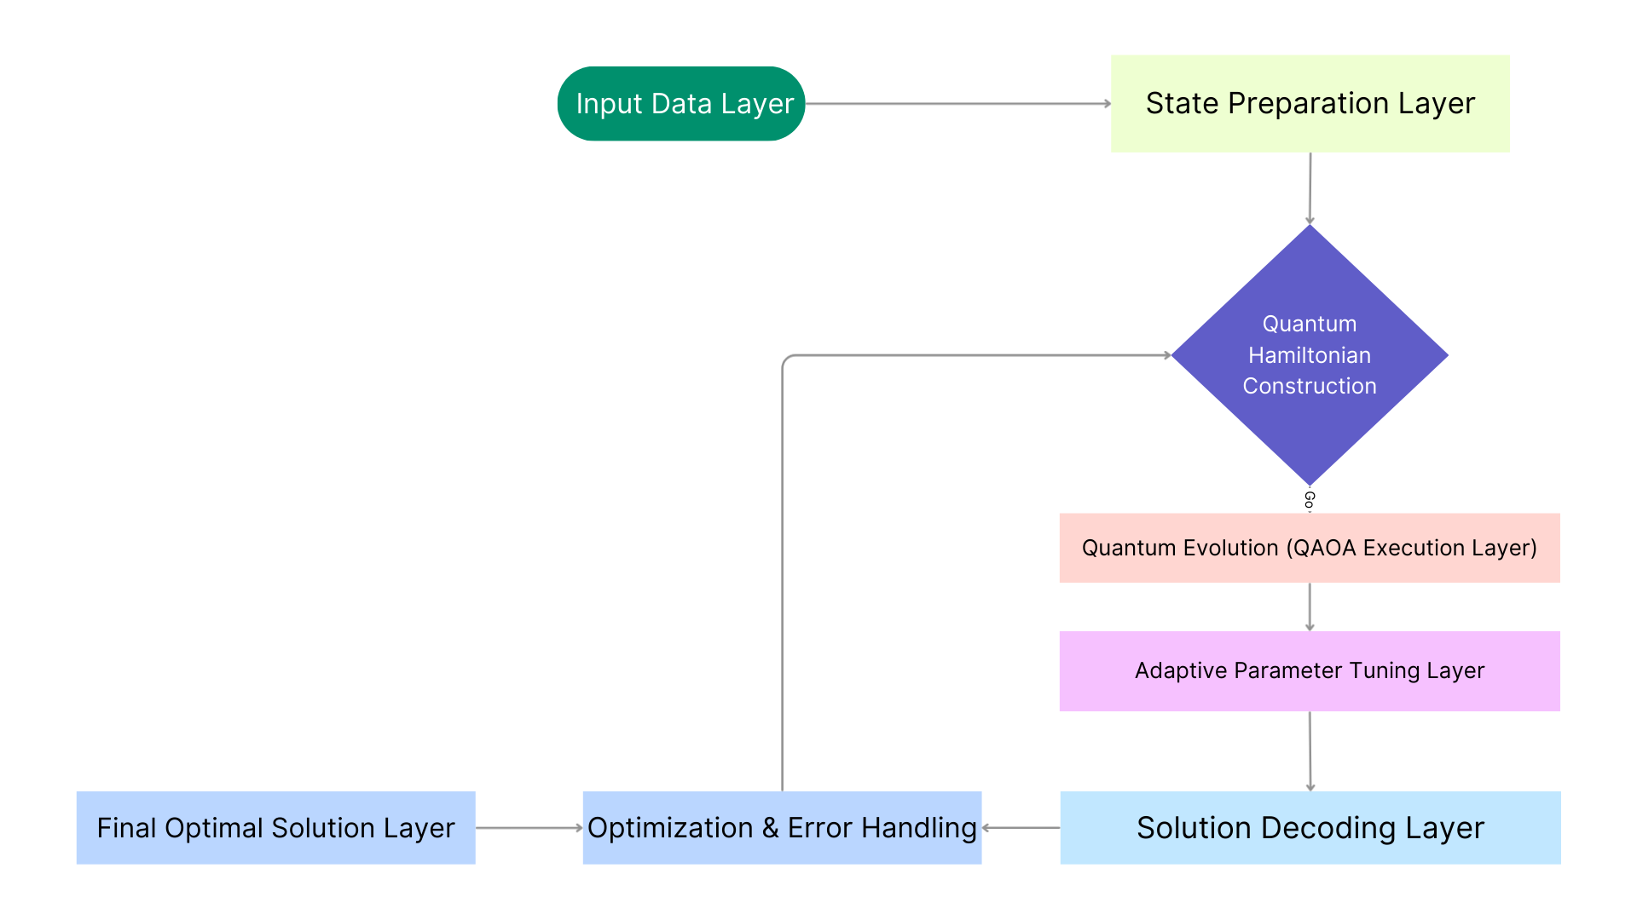
SYSTEM ARCHITECTURE
Department of Information Technology

Slide 10
IMPROVEMENTS
🔹 Adaptive Parameter Optimization: Automatically finds the best (γ, β) values instead of fixed Grover iterations.
🔹 Cost-Based Optimization Approach: Uses the Quantum Approximate Optimization Algorithm (QAOA) to directly minimize tour cost.
🔹 Reduced Circuit Complexity: Removes complex oracle design and reduces circuit depth.
🔹 NISQ Compatibility: Tested under noisy simulation, making it practical for real quantum devices.
Department of Information Technology

Slide 11
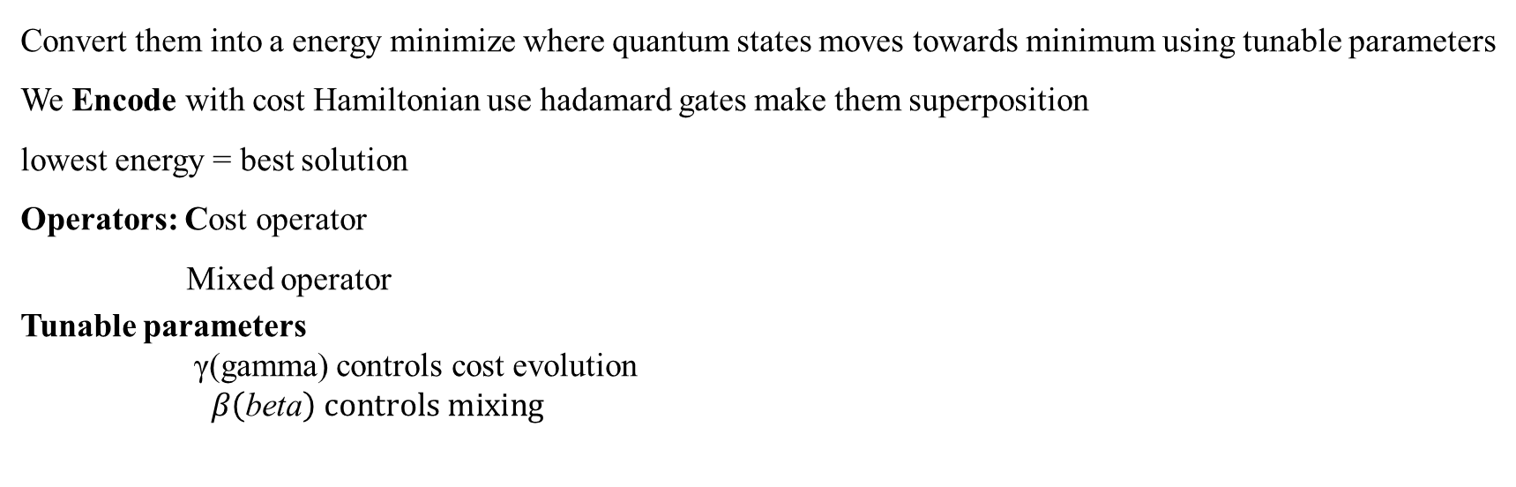
Why QAOA?
Convert them into a energy minimize where quantum states moves towards minimum using tunable parameters
We Encode with cost Hamiltonian use hadamard gates make them superposition
lowest energy = best solution
Operators: Cost operator
Mixed operator
Tunable parameters γ(gamma) controls cost evolution
$β\left(\text{beta}\right) controls mixing$
Department of Information Technology

Slide 12
Major Changes
Cost Hamiltonian
Mixer Hamiltonian adaptive parameter tuning
Oracle marking diffusion operating fixed iteration
Added
Removed
Department of Information Technology

Slide 13
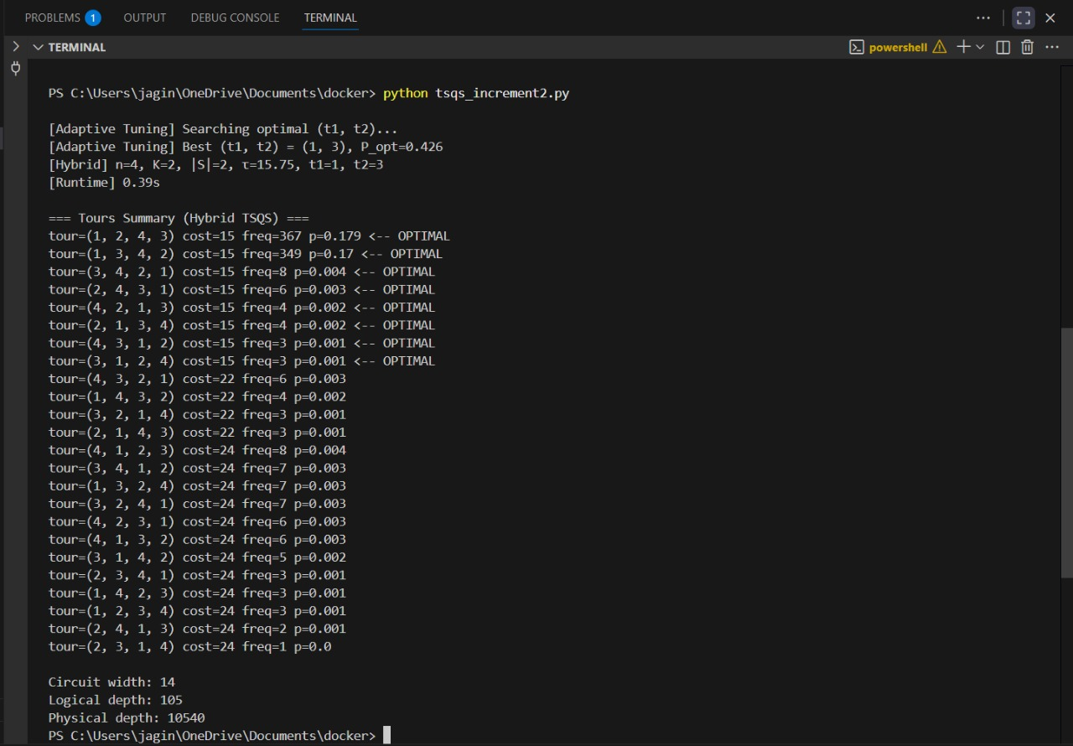
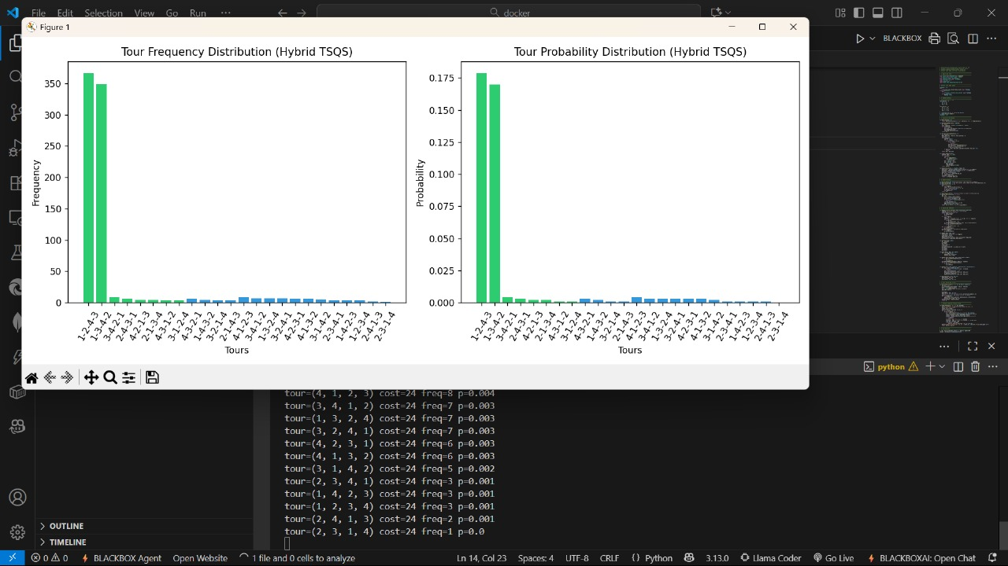
PREVIOUS RESULTS
Execution Output and Visualization of Hybrid TSQS (Case 1)
This figure shows the terminal output and simulation plots for the Hybrid Two-Step Quantum Search (H-TSQS) applied to a 4-city TSP instance. The adaptive tuning module identified the optimal parameters $\left(t_{1} , t_{2}\right)=\left(1 , 3\right)$with a peak success probability of 0.426. The histogram plots display the Tour Frequency Distribution and Tour Probability Distribution, highlighting that the minimal-cost tours are successfully amplified.
Department of Information Technology

Slide 14
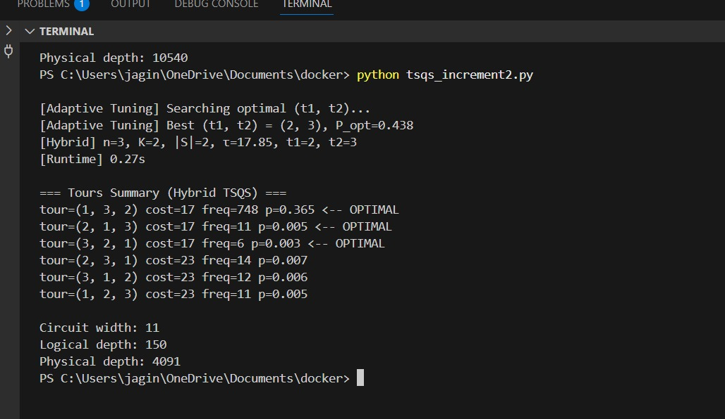
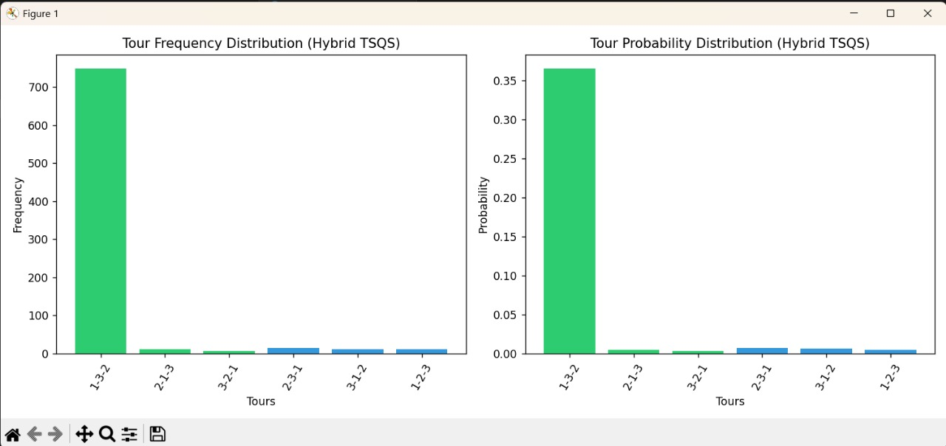
Execution Output and Visualization of Hybrid TSQS (Case 2)
This figure depicts another execution of H-TSQS with different city configuration $\left(n , =3k=2\right)$. The optimal parameters were found as $\left(t_{1} , t_{2}\right)=\left(2 , 3\right)$with a success probability of 0.438. The plots confirm the dominance of the optimal tour “1-3-2” in both frequency and probability distributions. The circuit width was 11 qubits, with a logical depth of 150 and a physical depth of 4091, demonstrating reduced resource requirements compared to the previous run.
Department of Information Technology

Slide 15
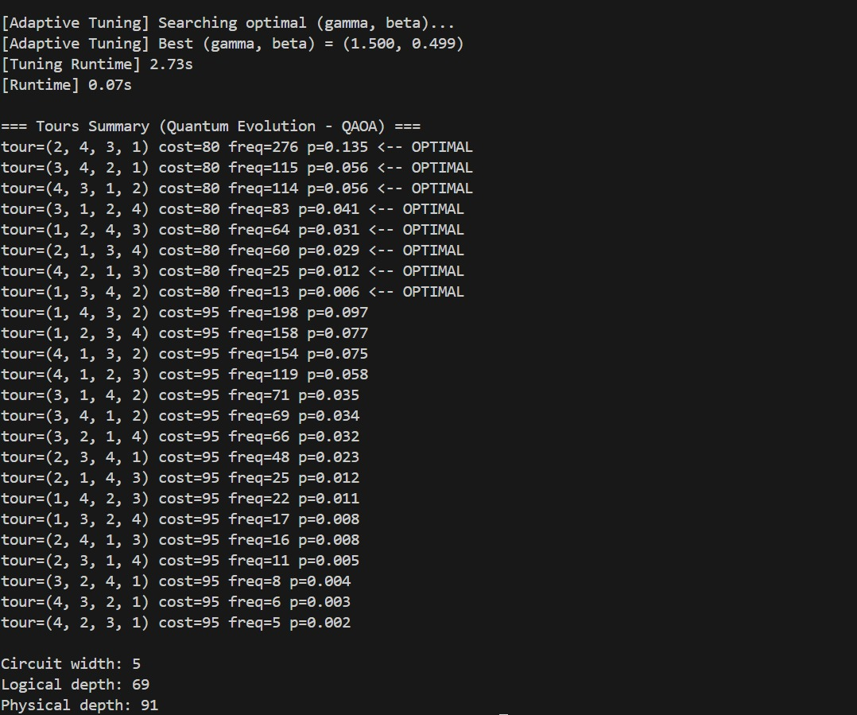
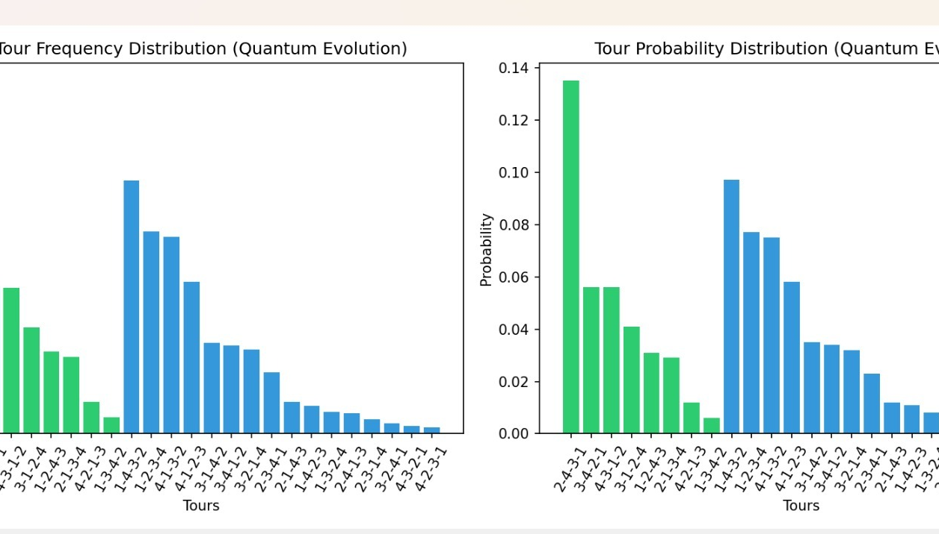
UPGRADED RESULTS
This figure shows the terminal output and plots for the QAOA-based method on a 3-city TSP. The adaptive tuning found optimal parameters (γ, β) = (0.112, 0.828), and the optimal tour (2,1,3) achieved the highest probability of 0.438 (cost = 17).
Department of Information Technology

Slide 16
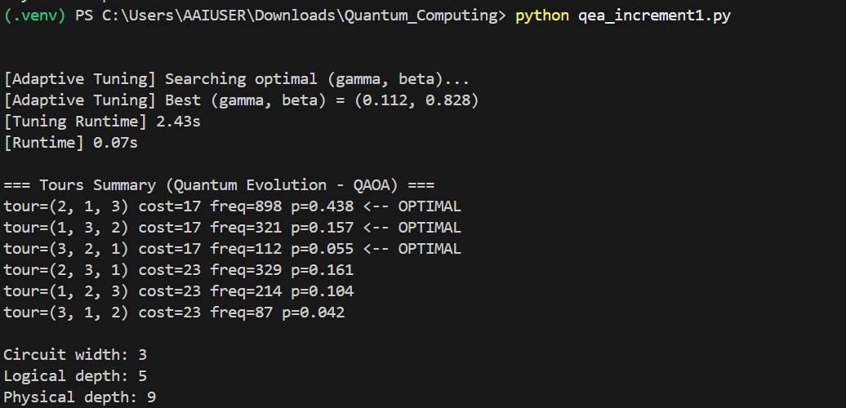
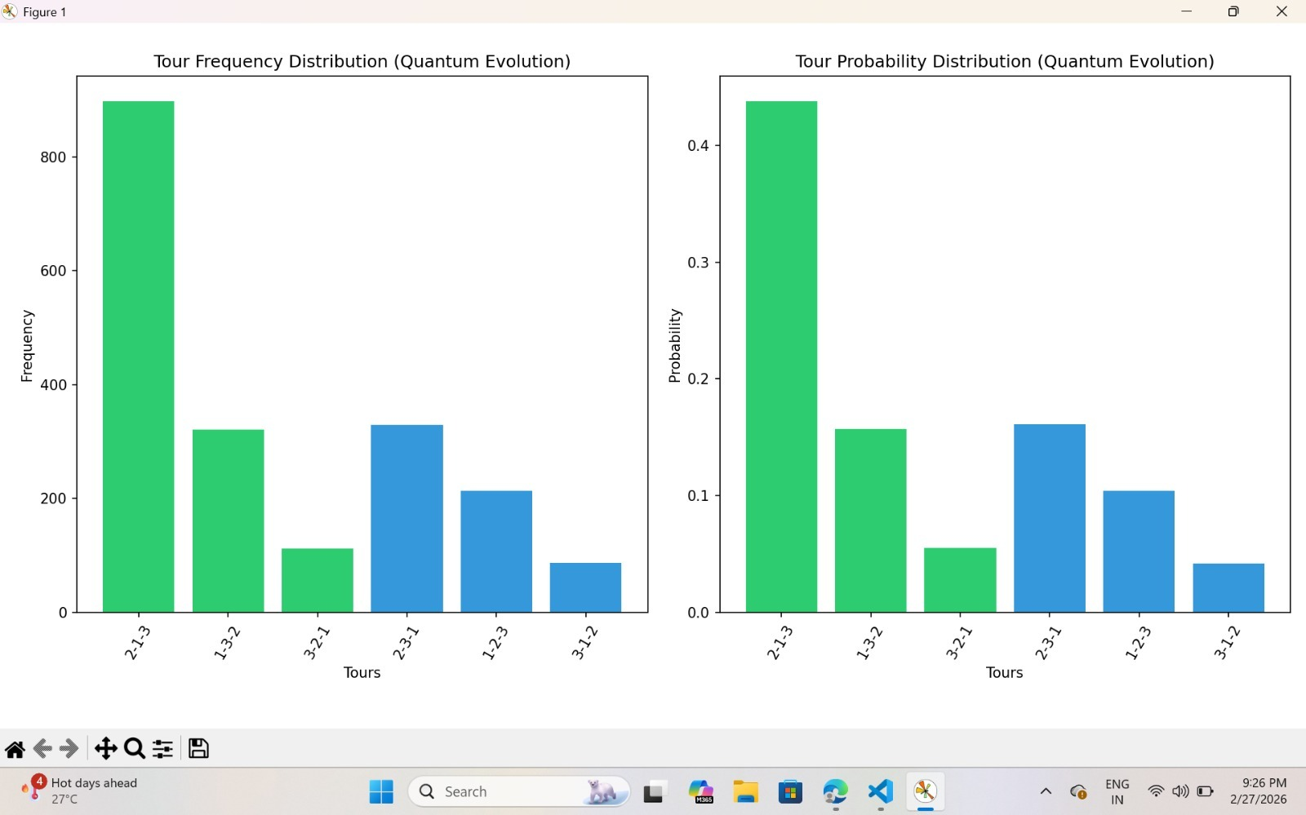
Execution Output and Visualization of Hybrid TSQS (Case 2) Using QAOA
This figure shows the terminal output and plots for the QAOA-based method on a 4-city TSP. The adaptive tuning found optimal parameters (γ, β) = (1.500, 0.499), and the minimum-cost tours (cost = 80) achieved the highest probability of 0.135.
The histograms show that lower-cost tours receive higher probability. The circuit uses 5 qubits with a logical depth of 69, demonstrating scalability to larger problems.
Department of Information Technology

Slide 17
THANK YOU
Department of Information Technology

